Slide 1

MatchiFi
SME Funding Matchmaking Platform

Slide 2

The SME Funding Challenge
SMEs face significant finance barriers, limiting growth.
45%
8%
30%
Funding Gap
Bank Loans
Women-Owned
Across SMEs
Only received by SMEs
Businesses are SMEs

Slide 3

Our Solution
MatchiFi connects SMEs with funders efficiently and transparently.
Automated Matching
Mobile-First
Seamless onboarding experience
AI-powered engine
Transparent Process
Clear funding approvals

Slide 4
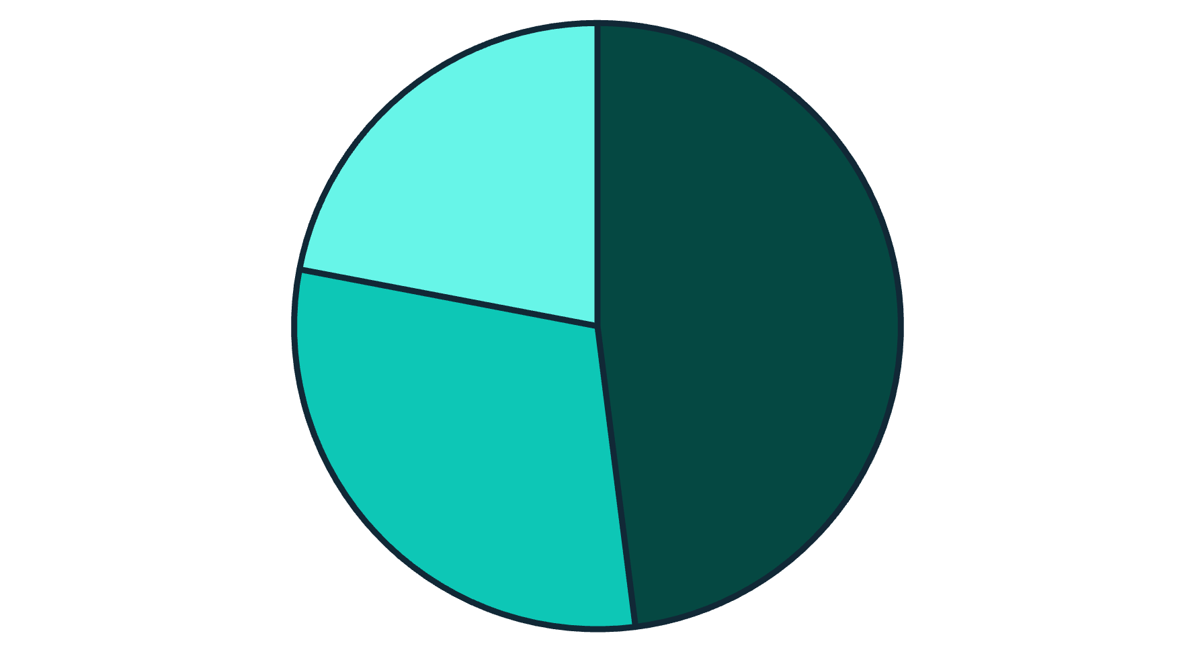
SME Market Opportunity
SME sector is a significant economic portion.
Micro-enterprises
Small businesses
Medium enterprises
Underserved segment with high growth potential, designed for local needs.

Slide 5



Why MatchiFi?
Enhanced visibility for funders and SMEs
Efficient, data-driven matching process
User-centric design for ease of use
Enhanced Visibility
Efficient Matching
User-Centric Design

Slide 6




Business Model
MatchiFi's revenue streams and growth strategy.
Freemium Model
SMEs join and explore funding
Commissions
Earned from successful funder matches
Strategic Expansion
Into SADC region markets

Slide 7
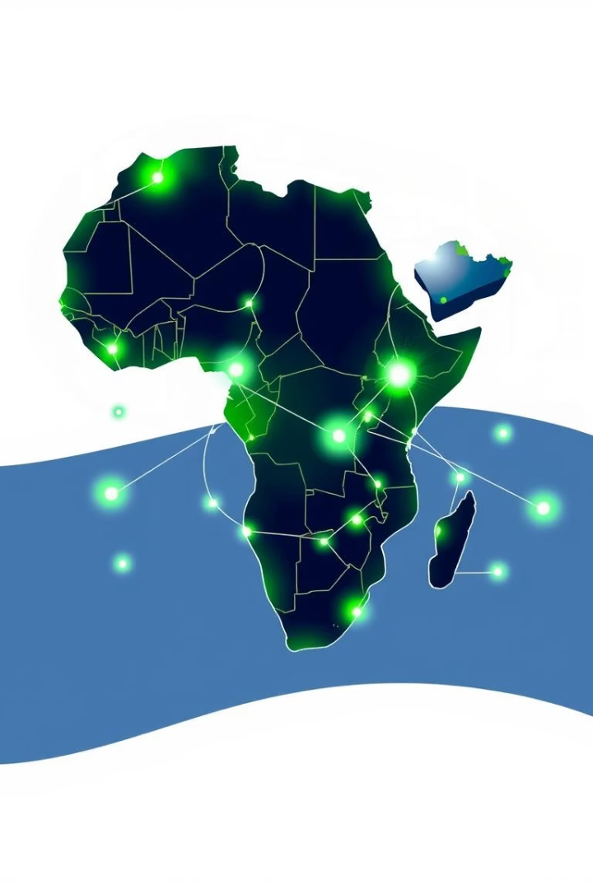
Growth & Future Vision
Leveraging data for insights and optimizing outcomes.
Data Leverage
Deep SME market insights
Enhanced Transparency
Better impact tracking
Funder Collaboration
Optimize social and economic outcomes
Pan-African Vision
SME funding infrastructure

Slide 8

Challenges & Mitigation
User data verification is crucial to prevent adverse selection risks.
Some users may be wary of new digital platforms.
The 'shadow banking' perception may deter certain users.
Growing competition is a challenge, but local partnerships offer differentiation.

